Slide 1
Mind modeling
Phoenix:
Venkateshkumar
Mahitha
Aiswarya

Slide 2
Abstract:
Human brain is considered to be a complex storage system unlike the hard disks and other storage devices the Brain has its own way of storing the data in a complex manner.
Here we are trying to find and store the neuron patterns of the brain in a computer database for some particular emotions and retrigger the neurons using the Optogenetics when ever the person wish to recreate the memories back.

Slide 3
Problem statement:
Do you remember your First kiss?
Do you remember how you felt on your first baby delivery.
Do you remember when your close one passed away?
Won’t you be happy to see a record of events happened at a particular time?
Want to cherish those moments again??

Slide 4
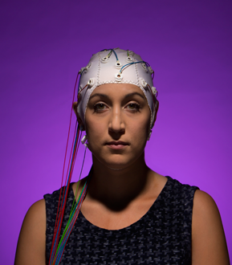
Upload your mind here:

Slide 5
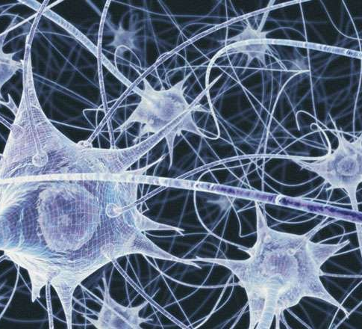
How brain works?
Trillions of neurons are present in human brain.
Network of neurons communicate each other with electric signals.

Slide 6
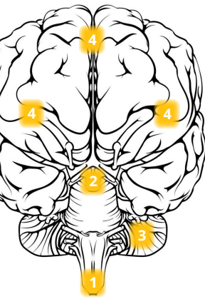
Brain Regions:
Brain Stem - Involuntary Actions (Heart Beat, Breathing)
Limbic System – Emotional Brain
Cerebellum – Voluntary Actions (Body movements, Postures)
Cerebrum or Cortex – Conscious thoughts

Slide 7
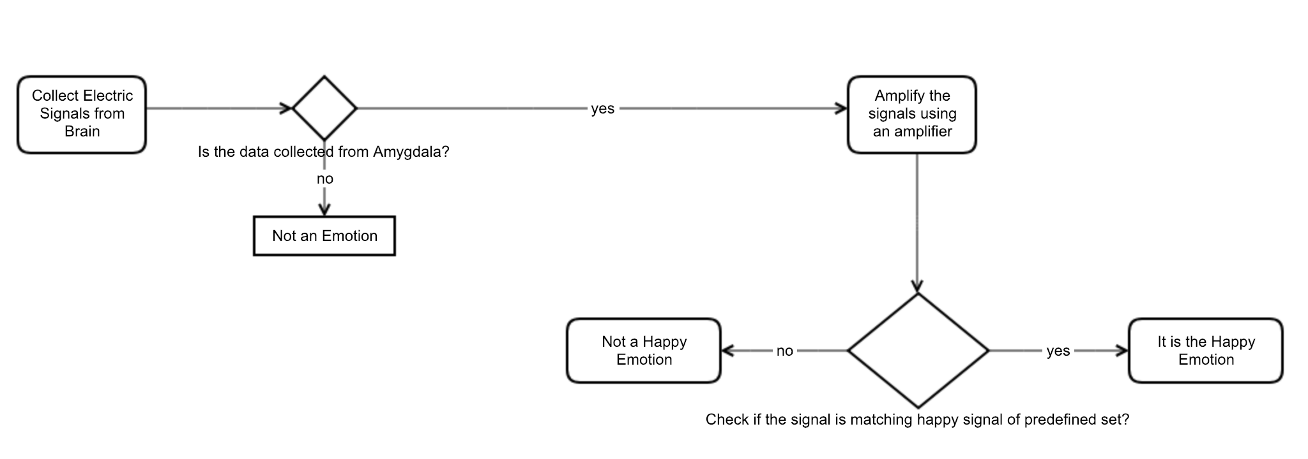
Collecting emotions:

Slide 8
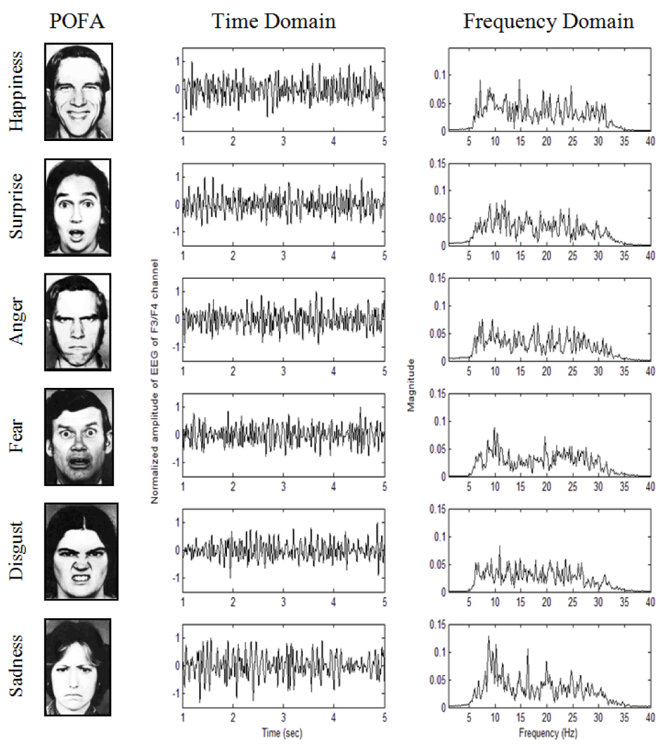
Predefined set:

Slide 9
Connectome:
Connectome is a comprehensive map of neural connections in the brain
We achieve connectome by BOINC – Barcoding the brain
In BOINC, each Neuron in the brain is labeled with a 20 ‘letter’ code using DNA nucleotides which represent A, C, T and G. With 20 ‘letters’, more than a trillion codes can be represented.

Slide 10
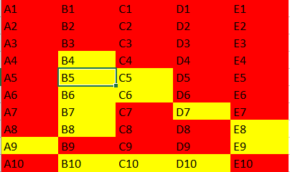
Connectome 1:
The neurons barcoded as B4,B5,C5,C6,D7,E8,E9,D10,C10,B10,A9,B8,B7,B6 forms a connectome for a particular time and the barcode values are stored in the table

Slide 11
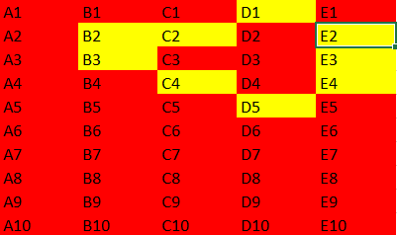
Connectome2:
The neurons barcoded as D1,E2,E3,E4,D5,C4,B3,B2,C2 forms a connectome for a particular time and the barcode values are stored in the table

Slide 12
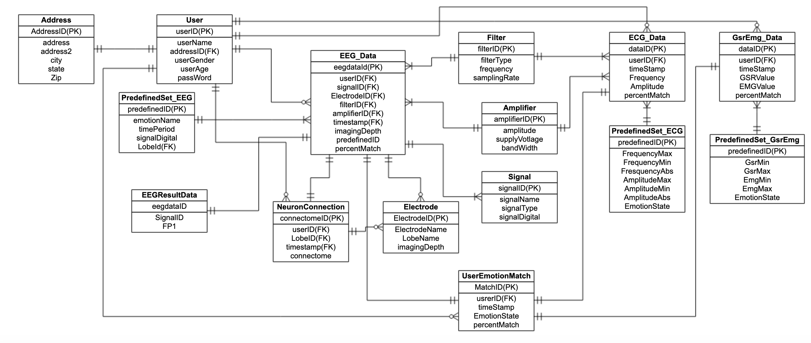
ER Diagram

Slide 13
Strategy/Plan
Detect the Emotion:
EEG
ECG
EMG
Neuron Pattern:
Using Neural Dust Technique

Slide 14
Arousal-Valence Space

Slide 15
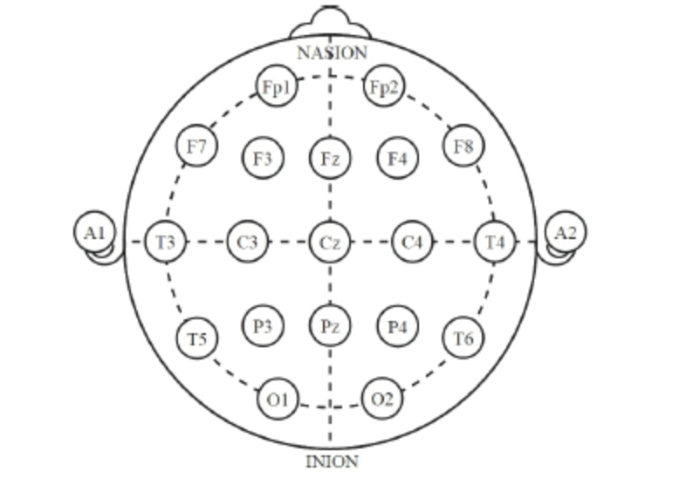
EEG

Slide 16
ECG

Slide 17
EMG-GSR
Galvanic skin response (GSR) is an indicator of skin conductance (SC), and increases linearly with a person’s level of overall arousal
Electromyography (EMG) measures muscle activity and has been shown to correlate with negatively valenced emotions.

Slide 18
Neural Dust

Slide 19
Coding
Scripts used:
Create.sql
Insert.sql
Queries.sql
users.sql
Functions used:
Get_div : calculate ratio
Get_pecent : calculate [percent
Triggers used:
Trigger name1: used for
Trigger name2: used for
Stored procedure used:
Procedure1: used for
Procedure2: used for
View used:
View1: used for
View2: used for

Slide 20
Thank you

